Slide 1

FINAL EXAM PROJECT
E-commerce Platform for Small Businesses
Project Management & Interpersonal Skills

Slide 2

TEAM
GROUP 1
Trisha Solanki - 201908254
Saiteja Keetha - 201906887
Shrey Sharma - 201908862

Slide 3
Introduction
Nearshop wants us to develope an application based on an already built web application, which should be in French, Dutch and English languages.
The application allows to :
manage the inventory by adding or editing goods
determine the level of accessibility for people with limited mobility (PRM)
schedule and administer the program of activities
manage the blog
The application provides the possibility to edit :
shop’s description, address, and contacts
working hours schedule
industry and categories of goods
accessibility data

Slide 4

Project Charter
PHASE 1
It is a document that describes your project in its entirety -
Detailed project goals
Roles and responsibilities
Identifies the main stakeholders
Reasons for undertaking the project
Objectives and constraints of the project

Slide 5
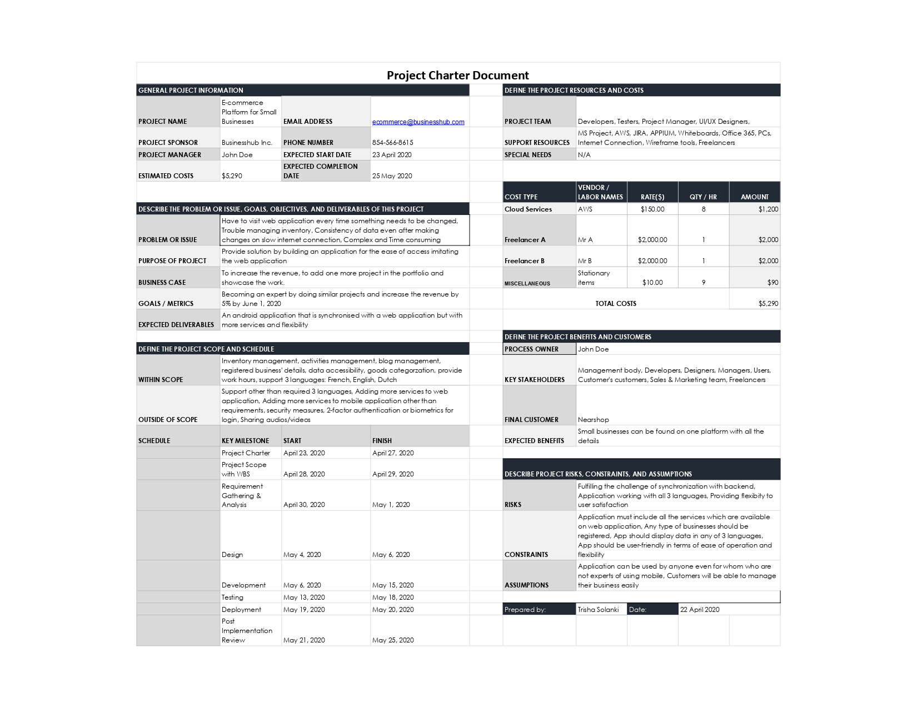

Slide 6


Identify Stakeholders
PHASE 2
Individuals and organizations who are actively involved in the project, or whose interests may be positively or negatively affected as a result of project execution or successful project completion.

Slide 7

Stakeholders
Internal
External
External Indirectly
Management Team (CEO, CTO, Director, etc.)
Sponsor(s)
Project Manager
IT Team (Developers, Designers, Freelancers, etc.)
Business Owners (Customers)
Investors
Employees of these businesses
Marketing and Sales Team
Buyers (Customer's Customers)
Suppliers

Slide 8
Stakeholders
Categories
Relationship
Internal
External
External Indirectly
Money
Communication
Product Development
Shopping
Supply
Use Application
Investment
Sponsorship
Salary
Marketing

Slide 9
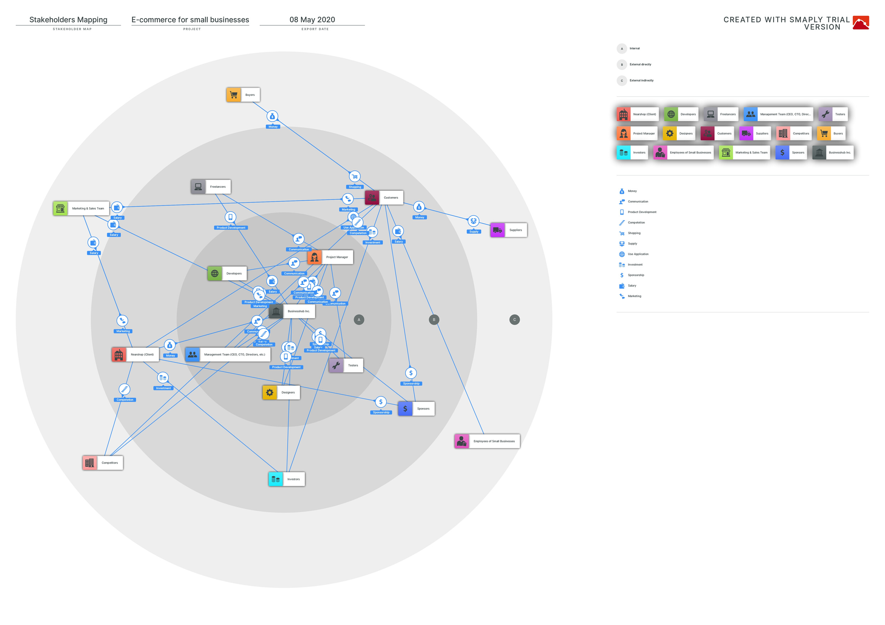

Slide 10

Project Deliverables
Project Charter Document
Stakeholders List
Project Deliverables
WBS
Gantt Chart and Network Diagram
Requirements List
Business Requirements
Business Requirements to Functional Requirements
Risks and Responses
5 types of conflicts and how to resolve them
Wireframes
Flowcharts, Use case diagram, and Sequence diagram
Application Architecture and Technical Design
Technical Design Document
PHASE 3

Slide 11


Application Implementation Plan
Front-end source code
Back-end source code
Report of Data Conversion and Synchronization
Detailed Test Plan
Test Scenarios, Test Cases, and Test Scripts
Test Results Documentation
Readiness Evaluations Reports
Application Defect Resolution Reports
Application Source Code and Documentation
Documented Implementation Project Closeout

Slide 12

Conflicts & Resolution
PHASE 4
5 Types of Conflicts
Resolution Types
Project Vision
Group Differences
Poor Leadership
Conflict Disagreements
Lack of Communication
Forcing
Smoothing
Withdrawing
Compromising
Problem Solving

Slide 13
Example
Conflict Type : Group Differences / Conflicts arisen from Cultural differences
As different cultures speak different languages, the people from outside of your community feel left aside and work will not be able to as smoothly as PM wants.
Resolution Type : Smoothing | Style : Accomodation
Introduce each other well and organize activities to mix the different people from different cultures. Try to use words of their language to make them feel comfortable

Slide 14

WBS
WORK BREAKDOWN STRUCTURE
PHASE 5

Slide 15

E1/1 PROJECT INITIATION AND PLANNING
E1/1.1 DEFINE PROJECT CHARTER
E1/1.2 IDENTIFY STAKEHOLDERS
E1/1.3 CREATE PROJECT DELIVERABLES
E1/1.4 CREATE SCOPE STATEMENT INCLUDING WBS
E1/1.5 CREATE PROJECT SCHEDULE AND TIMELINE
E1/1.6 CREATE PROJECT COMMUNICATION PLAN
E1/4 DEVELOPMENT
E1/4.1 APPLICATION IMPLEMENTATION PLAN
E1/4.2 FRONT-END DEVELOPMENT
E1/4.3 BACK-END DEVELOPMENT
E1/4.4 DATA CONVERSION, SYNCHRONIZATION, AND REPORTING
E1/4.5 APPLICATION MAINTENANCE, SUPPORT AND TRANSITION
E1/2 ANALYSIS
E1/2.1 REQUIREMENT GATHERING AND ANALYSIS
E1/2.2 GATHER BUSINESS REQUIREMENTS
E1/2.3 CONVERT BUSINESS REQUIREMENTS TO FUNCTIONAL REQUIREMENTS
E1/2.4 IDENTIFY 5 TYPES OF CONFLICTS AND HOW TO RESOLVE THEM
E1/2.5 IDENTIFY RISKS AND RESPONSES
E1/5 TESTING
E1/5.1 DETAILED TEST PLANS
E1/5.2 CREATE TEST SCENARIOS, TEST CASES, AND TEST SCRIPTS
E1/5.3 DOCUMENT TEST RESULTS
E1/5.4 ERROR HANDLING & IMPROVEMENTS
E1/3 DESIGN
E1/3.1 CREATE WIRE-FRAMES
E1/3.2 PREPARE FLOWCHARTS, USE CASE DIAGRAM, AND SEQUENCE DIAGRAM
E1/3.3 APPLICATION ARCHITECTURE AND TECHNICAL DESIGN
E1/3.4 CREATE TECHNICAL DESIGN DOCUMENT
E1/6 DEPLOYMENT
E1/6.1 RELEASE READINESS EVALUATIONS AND REPORTS
E1/6.2 APPLICATION DEFECT RESOLUTION REPORTS
E1/6.3 APPLICATION SOURCE CODE AND DOCUMENTATION
E1/6.4 DOCUMENTED IMPLEMENTATION PROJECT CLOSEOUT

Slide 16

Project Schedule and Timeline
GANTT CHART & NETWORK DIAGRAM
PHASE 6

Slide 17
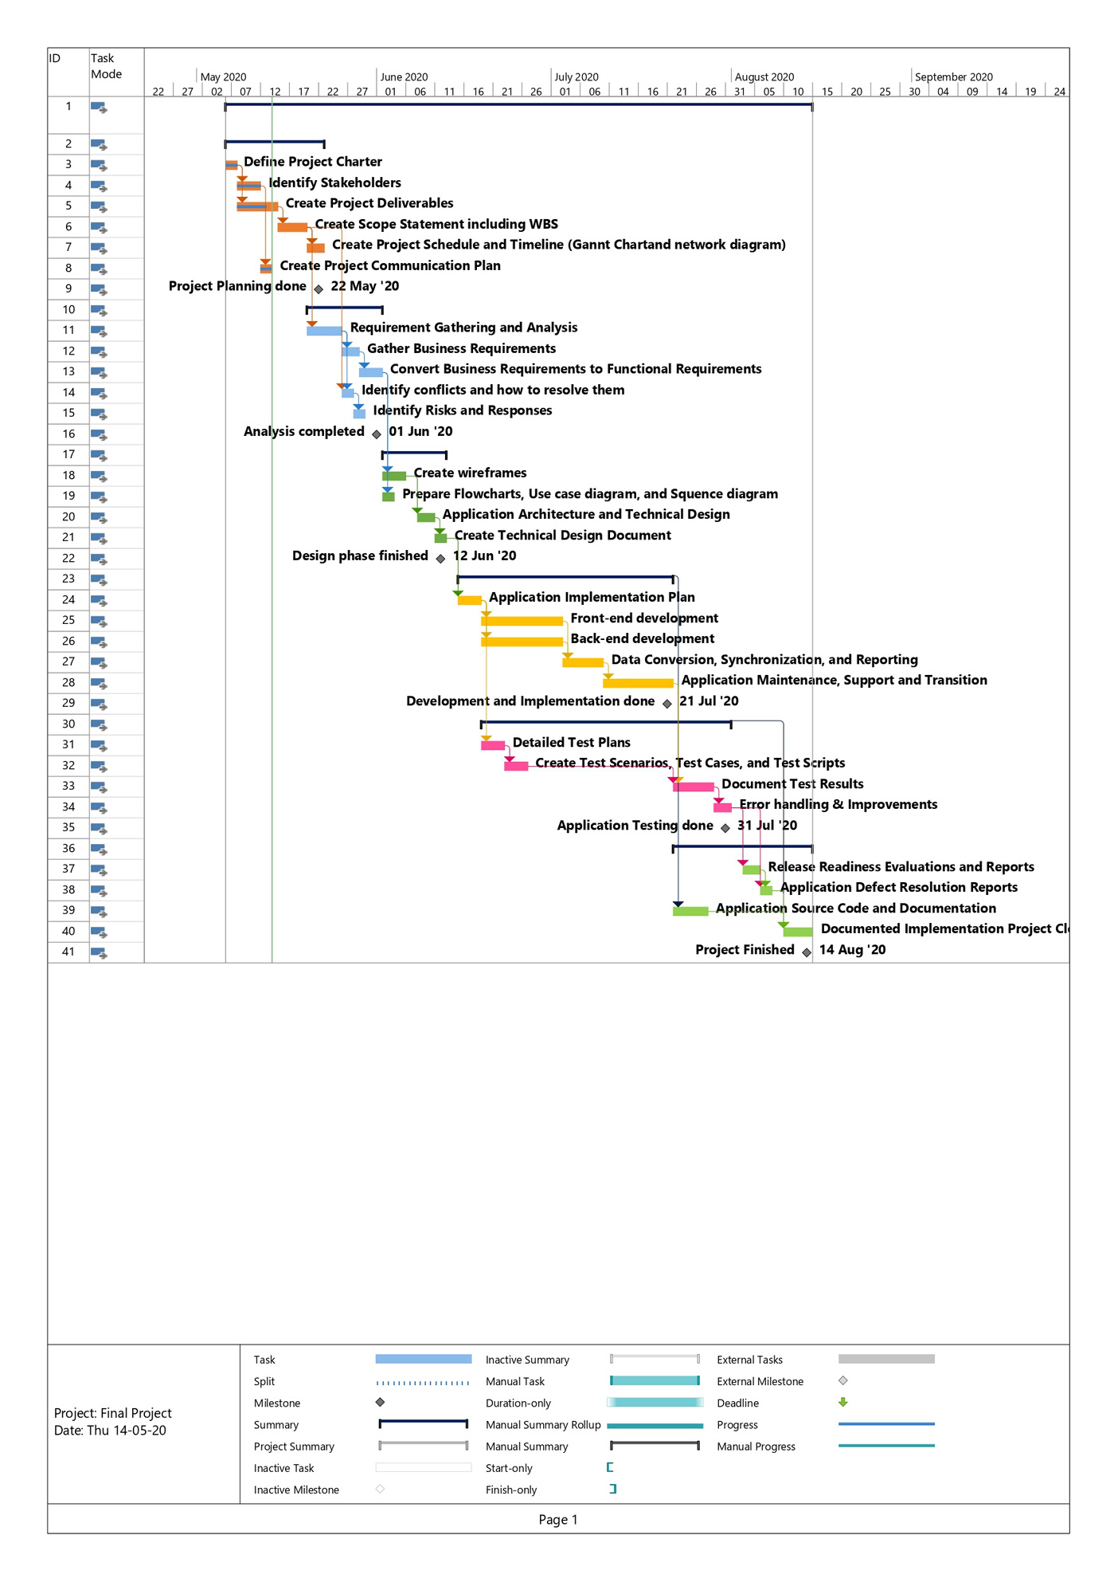
GANTT CHART

Slide 18
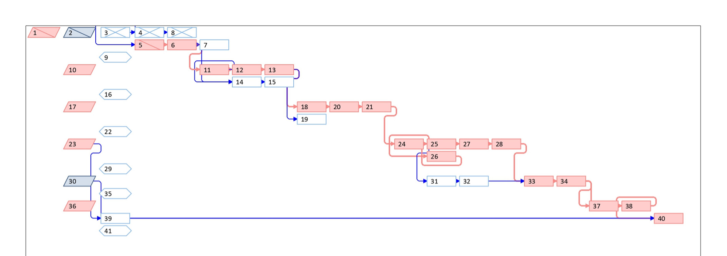
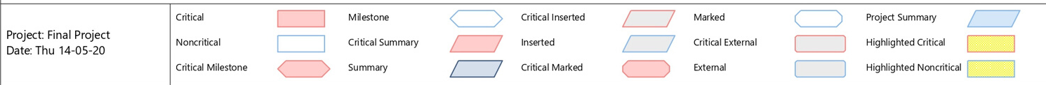
NETWORK DIAGRAM

Slide 19
Communication Plan
PHASE 7
Synchronous Communication
Asynchronous Communication
Meetings :
Team meeting (Daily)
Project review (At milestones)
Post-mortem meeting (At end of project)
Team stand-up :
Task progress updates (Daily)
Video Conference Calls :
Major work updates (Weekly)
Email :
Project status report (Weekly)

Slide 20


Risks & Responses
PHASE 8

Slide 21

Risks
Responses
What if the database will crash under the situation of multiple access?
What if the application won't be finished on time?
What if the customer brings new ideas and requirements once the development has started?
What if the freelancer(s) leave the work in the middle of the project under some circumstances?
What if the customer is not satisfied with the final product?
What if all the requirements won't be implemented by developers?
Keep the database on cloud services so that the whole database can be retrieved in such cases
Use fast-tracking technique to avoid such kind situation
You should always be ready to make the changes in application. Warn Designers and Developers about it beforehand
Keep the list of Freelancers in case if you need to hire new ones
Ask for feedback and make changes accordingly
Find an expertise or someone more experienced in this field and be ready to get help in times like this

Slide 22

Thank You!

